Slide 1


SAPTHAGIRI COLLEGE OF ENGINEERING
(Affiliated to Visvesvaraya Technological University, Belagavi& Approved by AICTE, New Delhi)
Department of Computer Science & Engineering
Project Phase-2 Review-2
Presentation
on
Heart Disease Prediction Using Novel
Quine McCluskey Binary Classifier
Presented by:
Name
Preetham S G
Santhosh D
Shravan L
Vivan Kushal Heneger
USN
1SG20CS082
1SG20CS094
1SG20CS100
1SG20CS114
Under the guidance of
Prof. SHWETHA K
Assistant Professor,
Dept. of C.S.E., S.C.E.
2023-2024

Slide 2
CONTENTS
Abstract
Introduction
Overall system architecture
Methodology
Modules description
Algorithms Used
Results
Conclusion

Slide 3
ABSTRACT
Improved diagnosis of cardiovascular disease and detection of high risk patients enabled by developing and evaluating an ensemble machine learning approach using logistic regression, decision trees, random forest, KNN, Naive Bayes, SVM and neural network models combined in a Quine McCluskey binary classification ensemble.

Slide 4
INTRODUCTION
The term ‘‘Heart Disease’’ (HD) is used to refer to a variety of pathological disorders that have an impact on the heart and blood vessels. It encompasses a variety of heart-related conditions, including but not limited to vascular diseases and disturbances in heart rhythm.

Slide 5
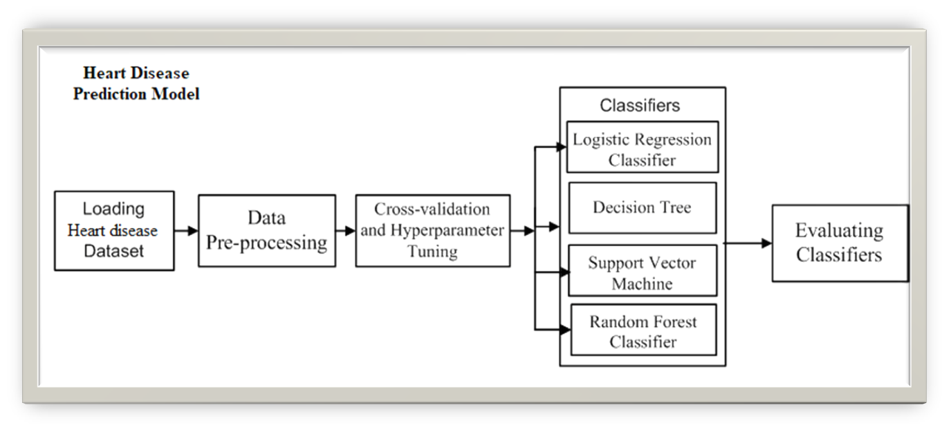
System Architecture

Slide 6
METHODOLOGY
In this project, a new ensemble Quine McCluskey Binary Classifier (QMBC) technique for identifying patients diagnosed with some form of heart disease and those who are not diagnosed.
The QMBC model utilizes an ensemble of models, including logistic regression, decision tree, random forest, K-nearest neighbour, naive bayes, support vector machine, and multilayer perceptron, and performs exceptionally well on multiclass class datasets.

Slide 7
MODULES
  DATA COLLECTION
  DATASET PREPROCESSING
  FEATURE EXTRACTION
  BUILDING ML MODULES
  PERFORMANCE EVAULATION

Slide 8
MODULES-DATA COLLECTION
This project utilizes a benchmark dataset that are publicly available in open repository. Several ongoing research studies utilize the Cleveland dataset from the University of California (UCI) as a standard to predict coronary heart disease.

Slide 9
MODULES-DATA PREPROCESSING
To ensure optimal performance and accuracy in ML, preprocessing is a crucial step that involves cleaning and preparing data before it is fed into a model for training.

Slide 10
MODULES-FEATURE EXTRACTION
FS is a critical process in ML that involves selecting the most relevant and informative features from a dataset to enhance a model’s performance.

Slide 11
BUILDING OF ML MODELS
This developing relationship between ML and cardiology has the potential to improve modern techniques for prediction and move the field closer to more accurate and reliable cardiovascular risk assessment.

Slide 12
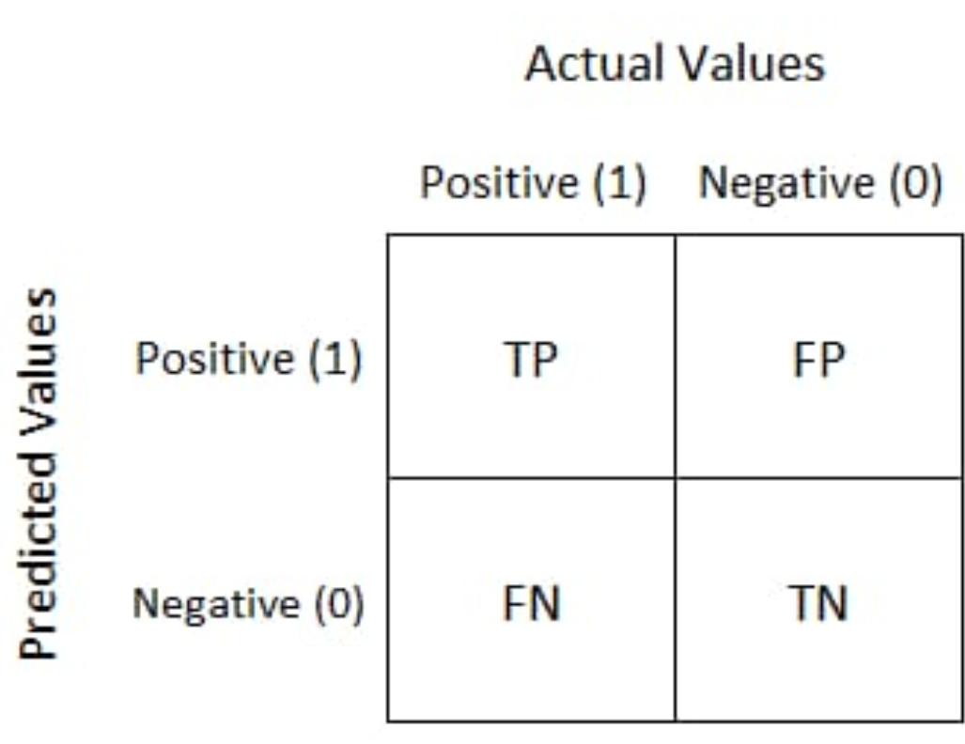
PERFORMANCE EVALUATION
To evaluate the performance of all models and proposed methodologies in this work, a confusion matrix is utilized. It provides an efficient and effective means of quantifying a model’s accuracy, precision, specificity, recall, and f1-score.

Slide 13
ALGORITHMS
  Logistic Regression
  Decision Tree
  Random Forest
  Navie Bayes
  Voting Classifier
  QMBC.

Slide 14
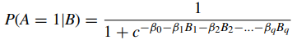
LOGISTIC REGRESSION
A logistic function is used in a LR model, which is a statistical method for modeling binary dependent variables. Classification problems commonly make use of LR.

Slide 15
RANDOM FOREST
It is an ensemble approach that combines different decision trees to enhance performance and reduce overfitting. The model functions by building several decision trees on various random subsets of data and then combining all of the trees predictions. It may be applied to both classification and regression problems.

Slide 16
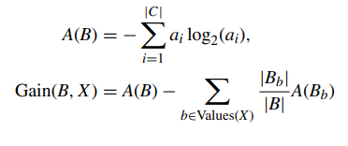
DECISION TREE
A versatile technique is the DT model, which employs a set of decision rules defined by branches and attributes represented by nodes, each of which is a leaf node expressing a class label. It may be used for problems involving classification and regression.

Slide 17
NAVIE BAYES
A probabilistic algorithm that calculates the probability of each class based on the input features is known as Naive Bayes. It is commonly used for text classification and other high-dimensional datasets.

Slide 18
VOTING CLASSIFIER
It is a method of ensemble learning that combines the results of various independent models to produce a single final prediction. It is a straightforward but efficient strategy that can raise the model’s overall effectiveness.

Slide 19
QUINE McCluskey BINARY CLASSIFIER (QMBC)
The Quine McCluskey method is an algorithmic approach to minimize the number of terms in a boolean expression. It is a two-step process that involves finding all the prime implicants and then grouping them to obtain a minimal boolean expression.

Slide 20
Quine McCluskey Method-ALGORITHM-1
Initialization: M₀ = set of minterms of f ,
  P₀ = set of prime implicants (PI) of f ,
  C₀ = set of all possible minterm groupings,
  i = 0.
while P_{i} is not empty do
  Generate M_{i+1}: Identify all minterms covered by each PI in P_{i} ,
  Combine the minterms that are covered by more than one PI.
  Generate P_{i+1}: Identify all PI that covers at least one minterm in M_{i+1},
  Remove redundant prime implicants.
  Generate C_{i+1}: Identify all potential groupings of minterms from M_{i+1}.
end while
Simplification:

Slide 21
Quine McCluskey Method-ALGORITHM-1
while there are groupings in C_{i+1} do
Choose an uncovered grouping c from C_{i+1}.
if there is a PI _{p} that covers c then
  Assign p to cover c.
  Remove c from C_{i+1}.
    else
    Combine the minterms in c to form a new PI q.
  Add q to P_{i+1}.
Remove c from C_{i+1}.
end if
end while
i = i + 1.
eg is the simplified Boolean function represented by the remaining PI.

Slide 22
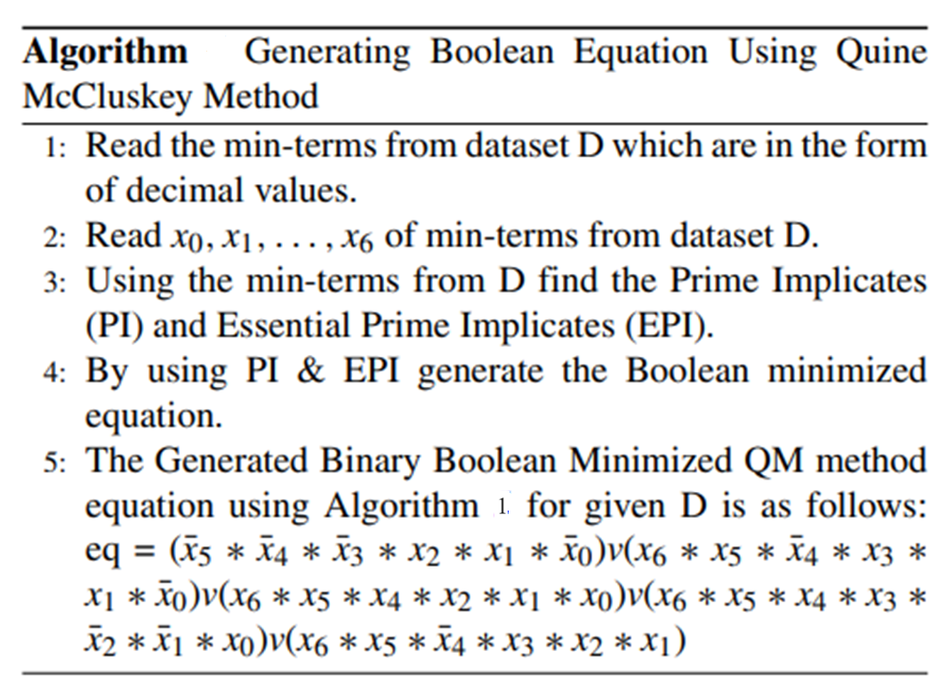
Generating Boolean Equation Using Quine McCluskey Method-ALGORITHM-2

Slide 23
Quine McCluskey Binary Classifier
1: Read the dataset and apply it to a 7 standalone ML models.
2: Create a new dataset that consists of the predicted results of all 7 ML models along with the target feature in CSV format.
3: Using Algorithm 6 find the Boolean minimized equation.
4: Split the boolean dataset into train and test of 80 : 20 ratio.
5: Using generated minimized equation from Algorithm 2 build the QMBC model with the train set.
6: Test the model with the remaining test set and calculate the performance of the QMBC model.

Slide 24
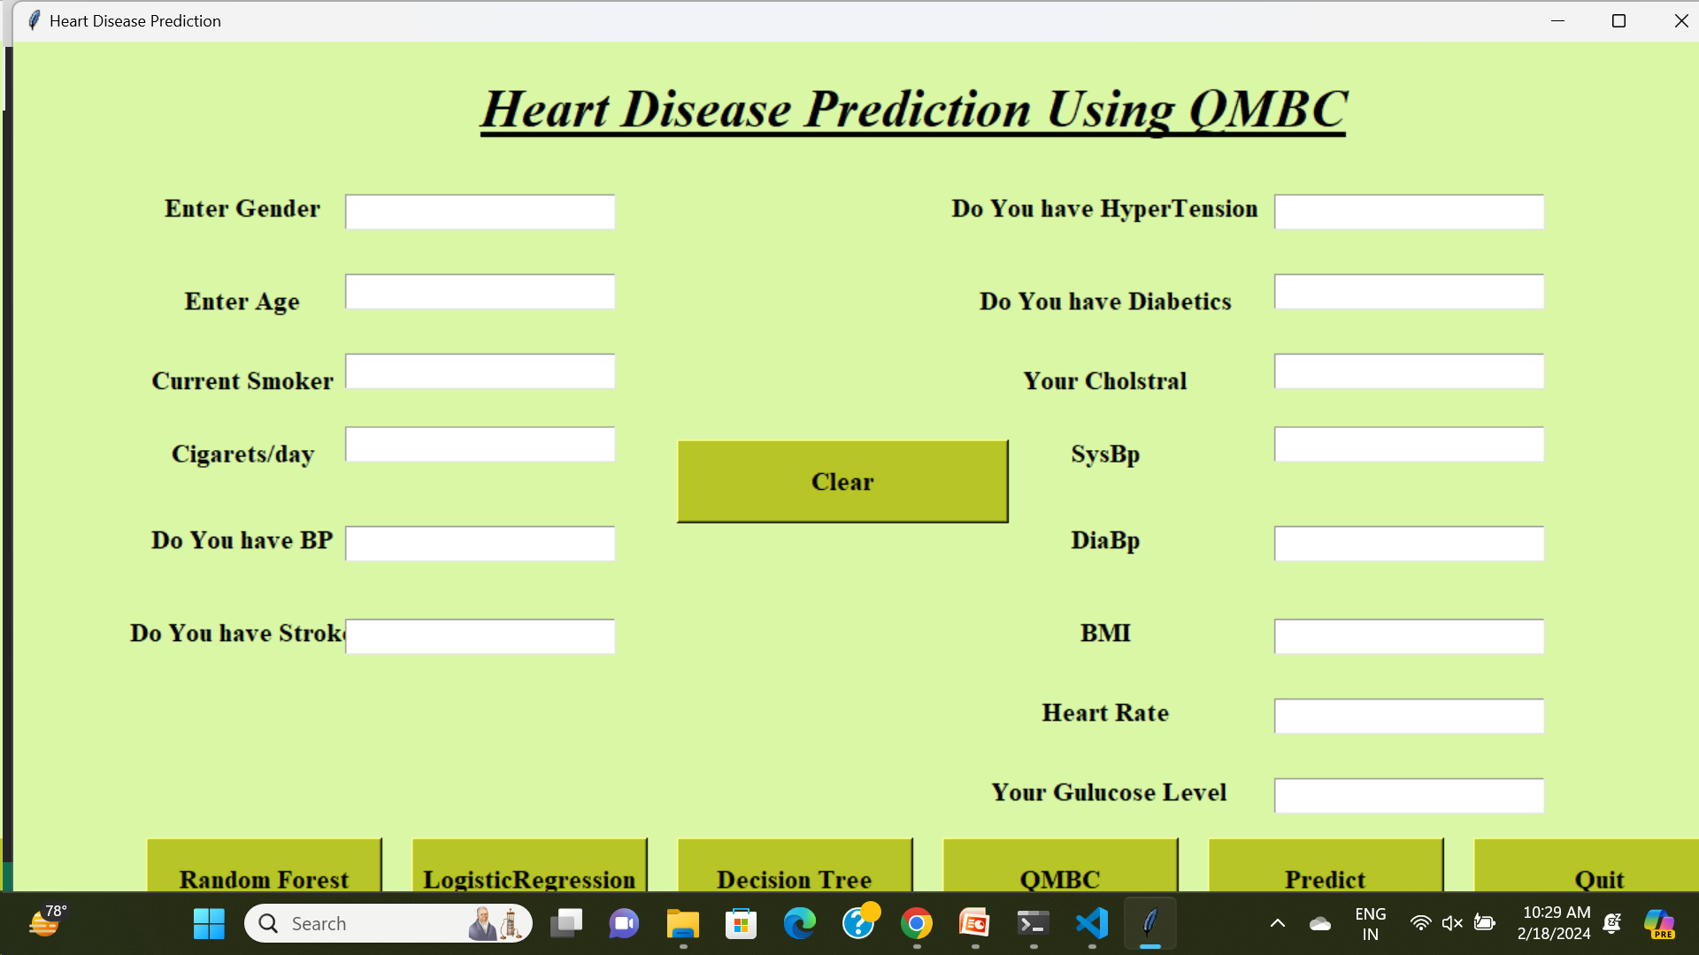
OUTPUT-GUI

Slide 25
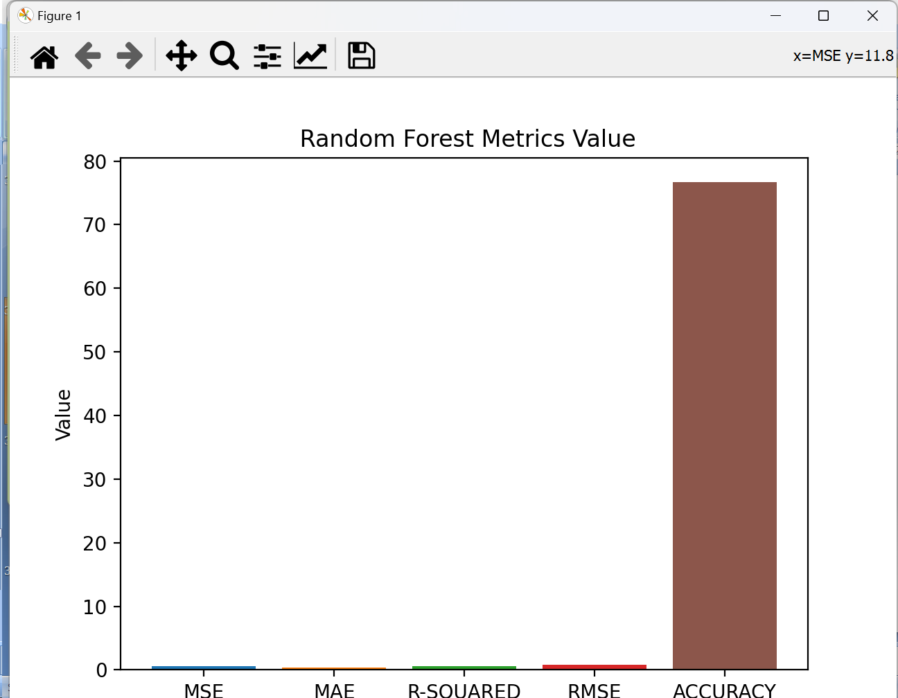
OUTPUT-RANDOM FOREST RESULT

Slide 26
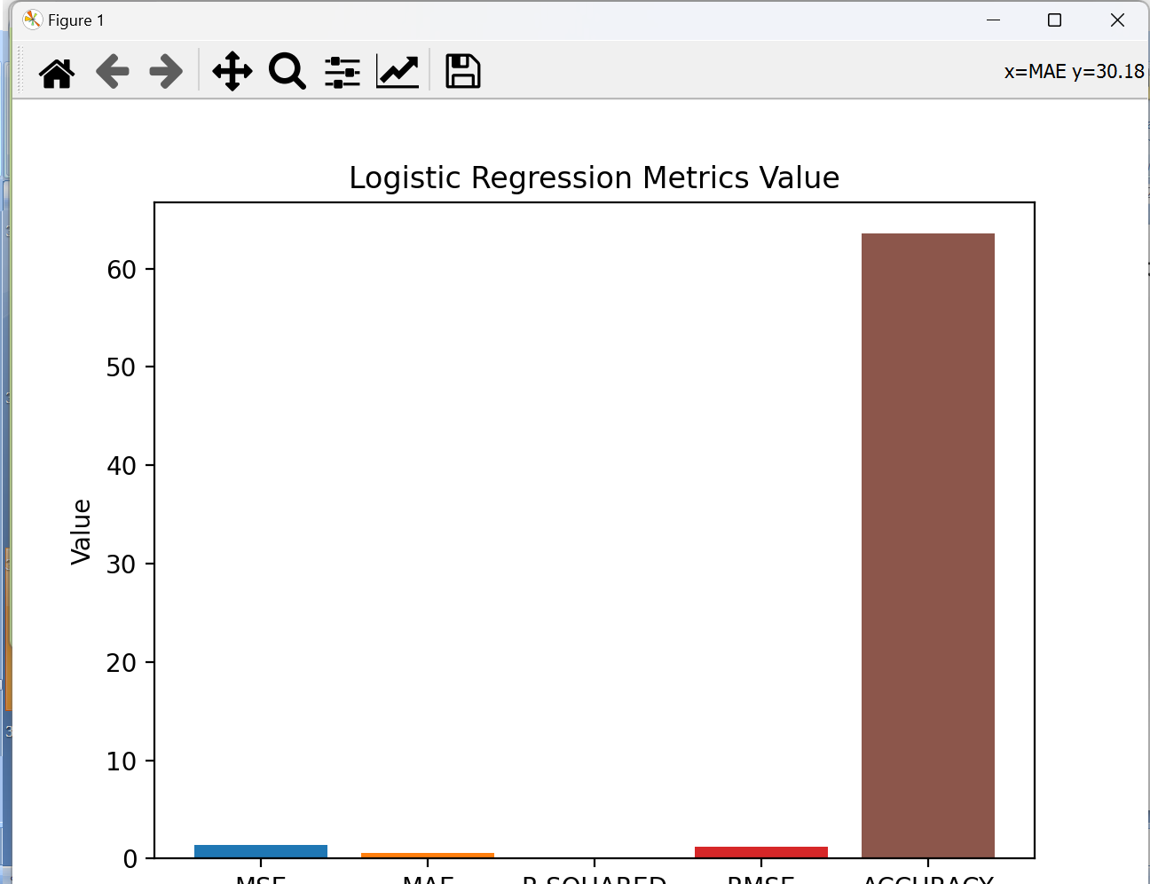
OUTPUT-LOGISTIC REGRESSION RESULT

Slide 27
CONCLUSION
The present study investigates the performance of five standalone ML models and a voting classifier using the Cleveland dataset
And by using the ML models and voting classifier it predicts the HD and classifies it into different stages.

Slide 28
THANK
YOU

